Slide 1
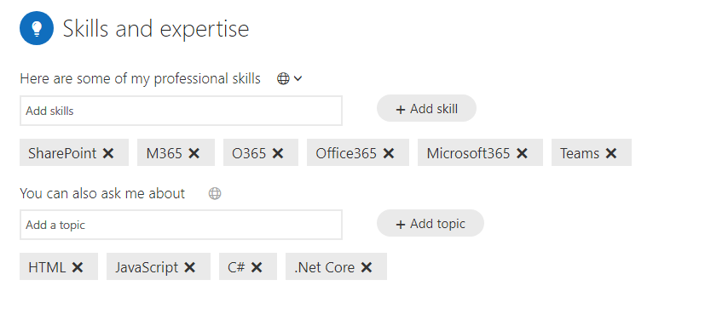
Extend IceBreaker
Finding Matches

Slide 2
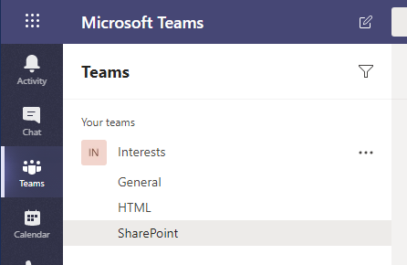

Extend IceBreaker
Teams
ActiveUsers
Profiles
ChannelMatches

Slide 3



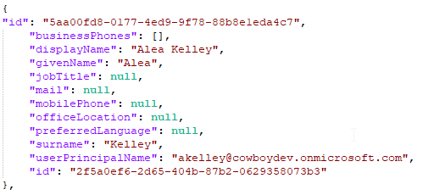
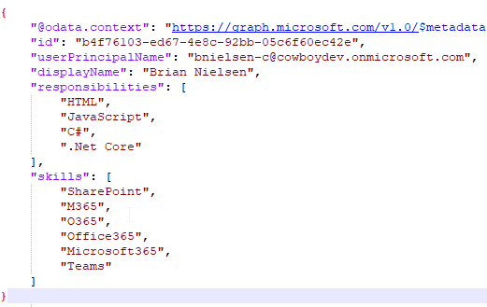
Extend Teams
ActiveUsers
GraphAPI
UserProfiles

Slide 4
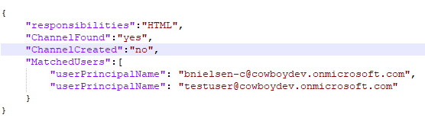
Extend Teams
UserProfiles
Profile Matches

Slide 5






Bot
Registration
App Service Plan
Icebreaker Bot
Logic App
App Service Plan
Cosmos DB
Teams
Users

Slide 6

Graph API
Get Active Users
Get User Profiles
Bot
Registration
Find Skill
Matches
Find User
Matches
App Service Plan
Icebreaker Bot
Add Channel to Teams
App Service Plan
Cosmos DB
Teams
Users
ActiveUsers
UserProfiles

Slide 7
What is a Teams app
Notes:
First lets define what actually is a Teams app.

Slide 8
What is a Teams app
The Microsoft Teams client
Teams app package
Manifest file
Icons
Web services
Notes:
A Teams app consists of three separate components. The Teams client, the Teams app package and any web services required to interact with the app. Apps built on the Microsoft Teams platform are bridges between the Teams client and your services and workflows. This brings them directly into the context of your collaboration platform.
The Teams app package are contained in a zip file that contains two image files and a manifest.json.
Microsoft Teams cannot host web services. The web services powering the app must be hosted and available via HTTPS over the internet.

Slide 9
Microsoft Teams platform UX Elements
The Microsoft Teams Platform provides flexible UI elements for apps to take advantage of.
Microsoft Teams platform elements:
Cards and card actions.
Task modules.
Deep links.
Web content pages.
Notes:
Teams UI/UX elements allow you to create rich experiences that feel native to the Teams client.
A card is a UI container for short or related pieces of information. Card can include buttons that trigger card actions.
Task modules can simplify the user experience for workflows that require data input. Gather input in a Teams-aware popup.
Deep links: You can create deep links to entities in Teams. Typically, this is used to create links that navigate to content and information within your tab.
A webpage you host can be embedded in a tab or a task module as a web content page.

Slide 10
Extendable points in Microsoft Teams
There are multiple places where the Microsoft Teams client can be extended to allow users to interact with the app.
Options for extending the Teams client:
Teams, channels and group chats
Personal apps
Messages
Notes:
Depending on your scenario you may choose to focus on a single extension point or combine multiple.
Teams, channels and group chats can be extended with conversational bots, configurable tabs, webhooks and connectors.
Personal apps can be extended with conversational bots and personal tabs
Messaging extensions allow users to interact with your web service through buttons and forms from the compose message area, the command box, or directly from a message. Your app can respond by presenting a form to the user to collect more information, sending a reply to the original message, or sending a message directly to the user.

Slide 11
App manifest
Notes:
The App manifest is a json file that holds the metadata that describes the Teams App.

Slide 12
App manifest
ManifestVersion
Version
Id
PackageName
Developer
Name
Description
Icons
AccentColor
Notes:
The manifest file requires the following metadata at a minimum.
ManifestVersion – right now there is only one version of the manifest, so this value should always be “1.0”
version – this is your version number.
id – this is a unique GUID for your application, and should match the application ID of your application in the App Registration Portal.
packageName – this is a unique, reverse domain notation name for your application
developer – there is some required information you have to provide regarding who you are. Your name, plus URLs to your website, privacy policy and terms of use are all required.
name – the name of your application which is shown to users. There is both a short and full name field, because the short field is limited to 30 characters.
description – similar to the name fields, there is a short and full description field.
icons –you need to provide both a 96×96 and 20×20 image for your application. The outline field is for the 20×20 icon, the color field is for the 96×96 icon.
accentColor – a hex code value starting with #, which is used by Teams to identify your application and provide some consistency between applications.

Slide 13
App Studio
Notes:
App Studio is a Teams app that allows editing of manifest files. It also allows installation of apps for testing and exporting apps to AppSource

Slide 14
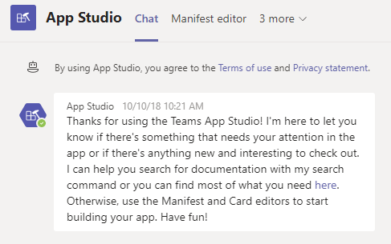
App Studio
App Studio streamlines the process of creating manifests and packages for Teams apps.
Use App Studio to:
Create and edit app manifests
Design and preview cards
Find documentation
Access UI controls in the control library
Notes:
App Studio streamlines the process of creating manifests and packages for Teams apps.
Use App Studio to:
Create and edit app manifests
Design and preview cards
Find documentation
Access UI controls in the control library to add in text boxes, buttons to apps.

Slide 15
App package components
Notes:
When deploying a Teams app there is a zip file that is used to supply the manifest and icons.

Slide 16
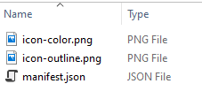
App Package
Three files required
Manifest file
Transparent “outline” icon
Full “color” icon
Notes:
The zipped file includes three files. Apps in Teams are defined by an app manifest JSON file, and bundled in an app package with their icons. You'll need an app package to upload and install your app in Teams, and to publish to either your app catalog or to AppSource.

Slide 17
Distributing a Teams app
Notes:
If you are the team owner and/or uploading custom apps is enabled, you can directly upload (or sideload) the app and start using it right away. However, if you want to share the app with others, you'll have to send them your app package and ask them to upload it independently.
Your organization's app catalog contains apps unique to your organization and is completely under your organization's control. You can find more information in the article Publish apps to your organization's app catalog. This feature can only be managed by Teams users with Microsoft Office 365 tenant admin privileges.
AppSource (formerly known as Office Store) provides a convenient location for you to distribute your Microsoft Teams app, as well as other Office 365 extensibility types such as Office add-ins and SharePoint add-ins.

Slide 18
Distributing a Teams App
Upload your app directly
Publish to your organization’s app catalog
Publish to AppSource (formerly knows as the Office Store)
Notes:
Sharing the app package directly is useful when the app is directed towards a limited audience.
If the app is applicable to a specific organization, a tenant administrator can upload the app to the organization’s app catalog.
If the app is intended for all Teams users, the app can be submitted for publication in the public app store. This involves a review process.
Because all app installations in Teams are context-specific, the entirety of an app may not always be installed for all users.

Slide 19
Understanding the components of a Microsoft Teams App
Notes:
https://github.com/MicrosoftLearning/MS-600-Building-Applications-and-Solutions-with-Microsoft-365-Core-Services/blob/master/Instructions/Labs/Lab04/Lab04-Extending-Teams-lab-instructions/02-Exercise-1-Understanding-the-components-of-a-Microsoft-Teams-app.md

Slide 20
Benefits of Deep Links
Notes:
Deep links provide a not only a link to the web correct web page but also passes data to an application on that page.

Slide 21
Benefits of Deep Links
Link that provides the correct Team, Channel, and Tab
Format of a deep link
Example of a deep link
https://teams.microsoft.com/l/entity/<appId>/<entityId>?label=Vi32&context=<context>
https://teams.microsoft.com/_#/files/General?threadId=19%3A42f3a244915b4ef39c3211a01ffc2066%40thread.skype&ctx=channel&context=General&rootfolder=%252Fsites%252Fdemo%252FShared%2520Documents%252FGeneral
Notes:
If you are the team owner and/or uploading custom apps is enabled, you can directly upload (or sideload) the app and start using it right away. However, if you want to share the app with others, you'll have to send them your app package and ask them to upload it independently.
Your organization's app catalog contains apps unique to your organization and is completely under your organization's control. You can find more information in the article Publish apps to your organization's app catalog. This feature can only be managed by Teams users with Microsoft Office 365 tenant admin privileges.
AppSource (formerly known as Office Store) provides a convenient location for you to distribute your Microsoft Teams app, as well as other Office 365 extensibility types such as Office add-ins and SharePoint add-ins.

Slide 22
Task Modules
Notes:
Task modules build on the concept of tabs and allow a modal experience in the Teams app.

Slide 23
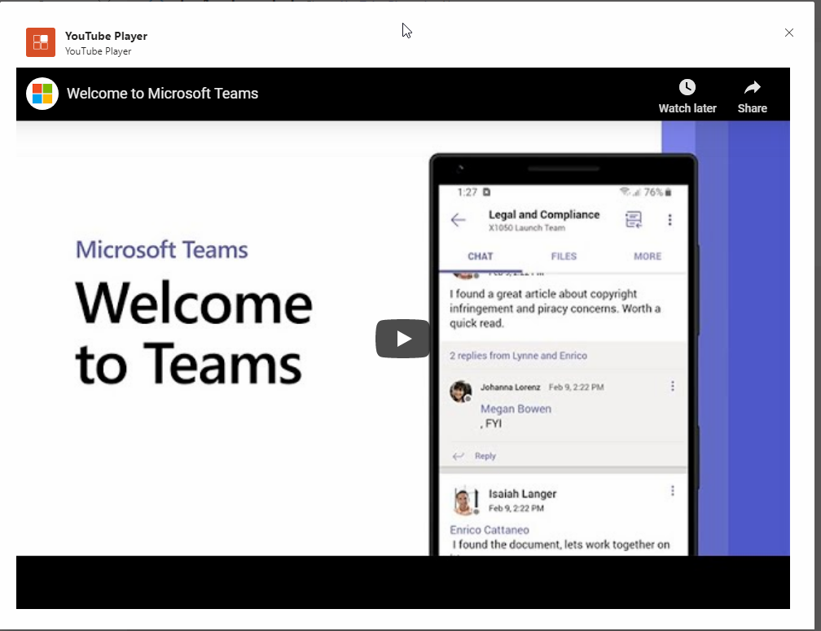
Task Modules
Modal popup in a Teams app
Notes:
Task modules allow you to create modal popup experiences in your Teams application. Inside the popup you can run your own custom HTML/JavaScript code, show an <iframe>-based widget such as a YouTube or Microsoft Stream video or display an Adaptive card. They are especially useful for initiating and completing tasks or displaying rich information like videos or Power BI dashboards. A popup experience is often more natural for users initiating and completing tasks compared to a tab or a conversation-based bot experience.
Task modules build on the foundation of Microsoft Teams tabs; they are essentially a tab inside a popup window. They use the same SDK, so if you've built a tab you are already 90% of the way to being able to create a task module.

Slide 24
How to Create a Widget

Slide 25
Summary
What is a Teams app?
App manifest
App Studio
App package components
Distributing a Teams app
Benefits of Deep links
Task modules
Notes:
Alright, so we’ve reached the end of this module, lets review what we discussed. We first defined what defines a Teams app. Then we covered the metadata inside the app manifest. We also covered how the components of a Teams app are packed and how they are added to App Studio. From App Studio we explained the options available for distributing the app. We covered the benefits of Deep links and finally explained Task modules.
If you haven’t yet, now’s a good time to go and review any of the referenced Microsoft documentation links found in this module, or search the documentation further on a particular subject where you’d like more information.
When you’re ready, let’s move on to the next module, Webhooks in Microsoft Teams

Slide 26
Notes:
Thanks for listening to [Module Name].
My name is [Author].

